Slide 1

Stock Market Analysis

Slide 2
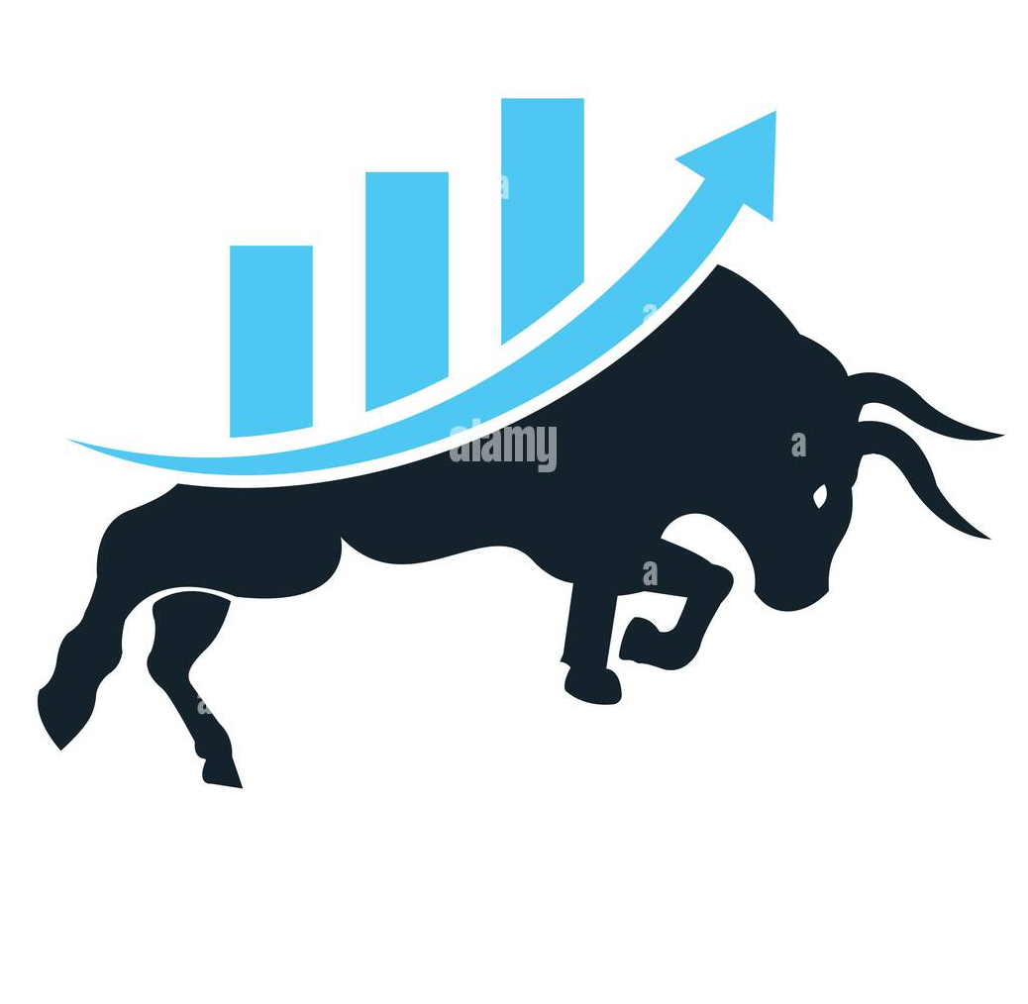
This project is based on a Stock Market dataset containing details of companies, exchanges, prices, volumes, dividends, categories, traders, and months.
The aim is to understand market capitalization, volatility, performance, sector behavior, and trading patterns using multiple dashboard tools.
Data spans multiple companies listed under NASDAQ & NSE, including tech, pharma, banking, and consumer sectors.
INTRODUCTION

Slide 3
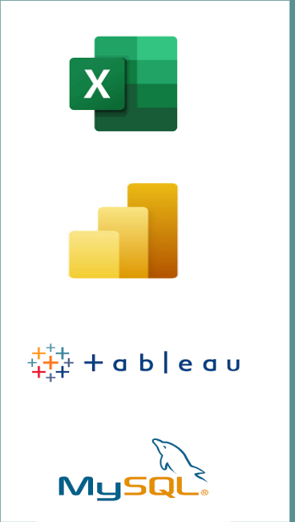
Excel: For static dashboards, price–volume analysis, pivot charts
Power BI: For dynamic dashboards, filters, interactive comparisons
Tableau: Visual storytelling, trend analysis, sector performance
SQL: Used for joins, price calculations KPIs
TOOLS USED

Slide 4
To analyze market capitalization, volatility, and trading performance.
To study sector-wise share distribution and dividend distribution.
To identify top shareholders, high-volume sectors, and buy-sell trends.
To visualize insights using Excel, Power BI, Tableau, and SQL.
To provide data-driven recommendations for traders and investors.
OBJECTIVES

Slide 5
METHODOLOGY
DATA COLLECTION
DATA CLEANING
DATA ANALYSIS USING EXCEL AND SQL
DATA VISUALIZATION USING POWERBI AND TABLEAU
INSIGHTS AND CONCLUSION

Slide 6
Key Performance Indicator’s
Total Market Capitalization
Trader Performance (P&L)
Volatility
Portfolio Return %
Average Daily Trading Volume
Top Performing Sector
Sharp Ratio
Trade Win Ratio
Order Execution Rate
Dividend Yield
Portfolio Value

Slide 7

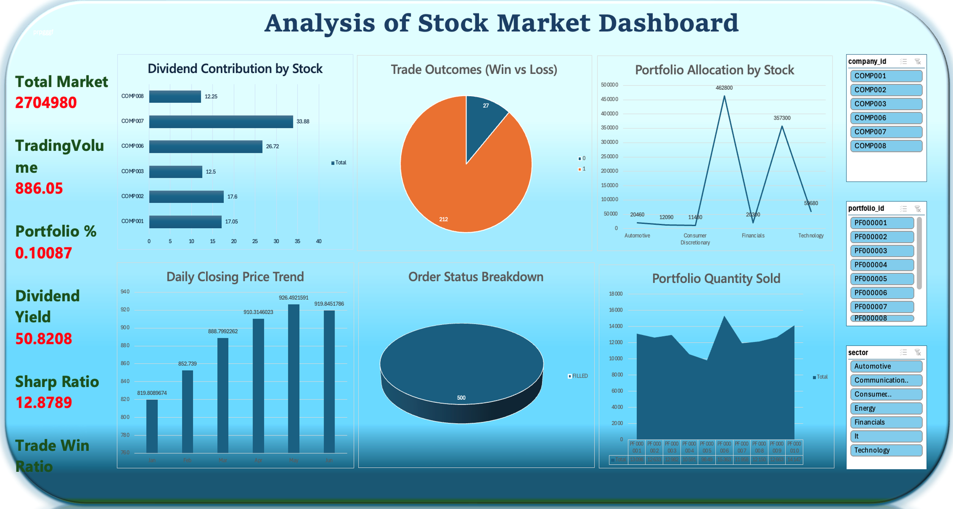
EXCEL DASHBOARD

Slide 8

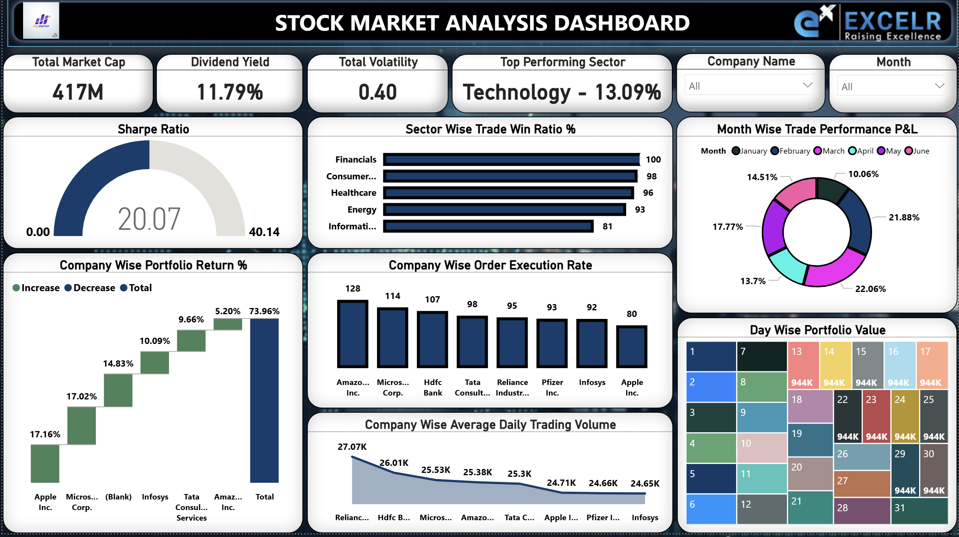
POWERBI DASHBOARD

Slide 9

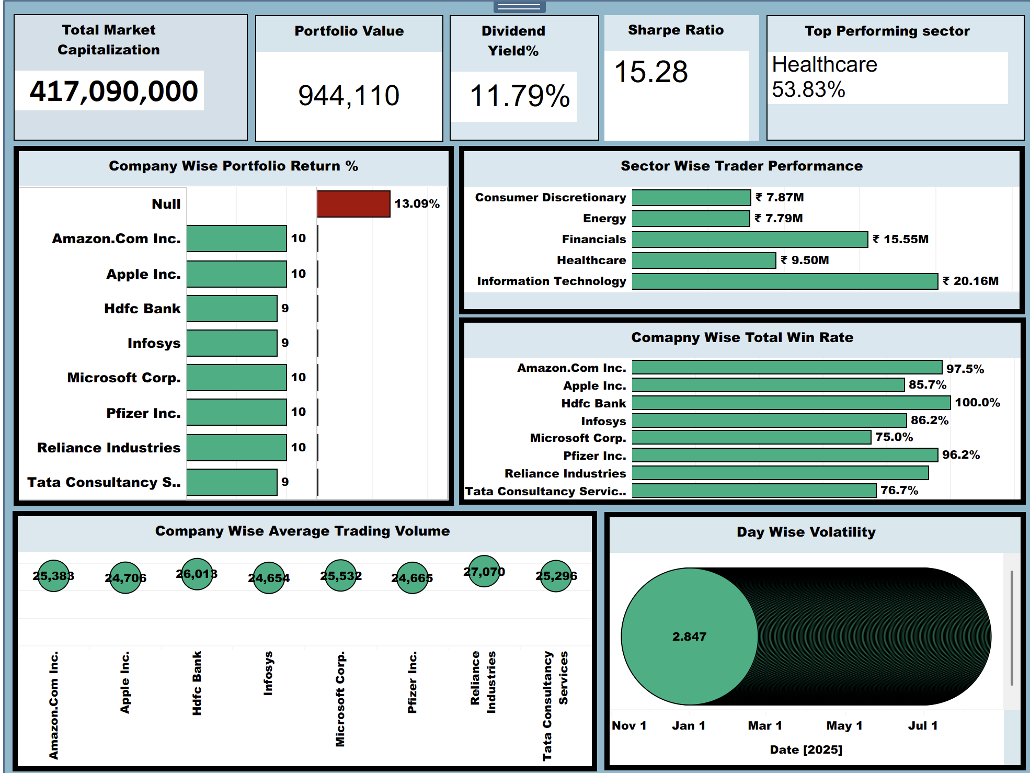
TABLEAU DASHBOARD

Slide 10
CHALLENGES
KPI values showing blank or incorrect percentages
Aggregation-level mismatch across tools
Relationship confusion between tables
Inconsistent results between Excel and Power BI
Difficulty calculating risk-adjusted metrics like the Sharpe Ratio

Slide 11
Manager wise total buy and Sell Value and Total_portfolio_returns
select manager,count(DISTINCT order_id) as Executed_trade,
concat(round(sum(case when side="BUY" then price* Quantity else 0 end)/1000000,2)," ","M")as Total_Buy_Value,
concat(round(sum(case when side="SELL" then price* Quantity else 0 end)/1000000,2)," ","M")as Total_Sell_Value,
concat(round(sum(price* Quantity)/1000,2)," ","k") as Total_portfolio_return,
concat(round(sum(close)/10000,2)," ","M") as Total_current_value
From stockanalysis group by manager order by Total_portfolio_return desc;
Conclusion
This Stock Market Trading Analysis project delivers a complete analytics pipeline built on real trading data.
The analysis covers 500+ trade records across 8 companies and multiple market sectors
The portfolio achieved a total market capitalisation of USD 270.49 million
The portfolio value stands at USD 944,110, with a portfolio return of 10.09%
Risk and stability were evaluated using Volatility: 0.40%
Sharpe Ratio: 12.57, indicating strong risk-adjusted performance
Income metrics show a Dividend Yield of 0.97%
Operational efficiency is reflected by Order Execution Rate: 99.80%
Trade Win Ratio: 88.70%
Trade Performance P&L: USD 21,836 profit
Using Excel, SQL, Power BI, and Tableau, this project transforms raw stock market data into validated KPIs and interactive dashboards, enabling clear evaluation of portfolio performance, risk, and trading efficiency.

Slide 12
THANKYOU
Group Members
Chaitra S S
Malathi N
Ankitha Pandey
Vinita Pal
Fiza Khan
Surjendu Naskar

